Slide 1
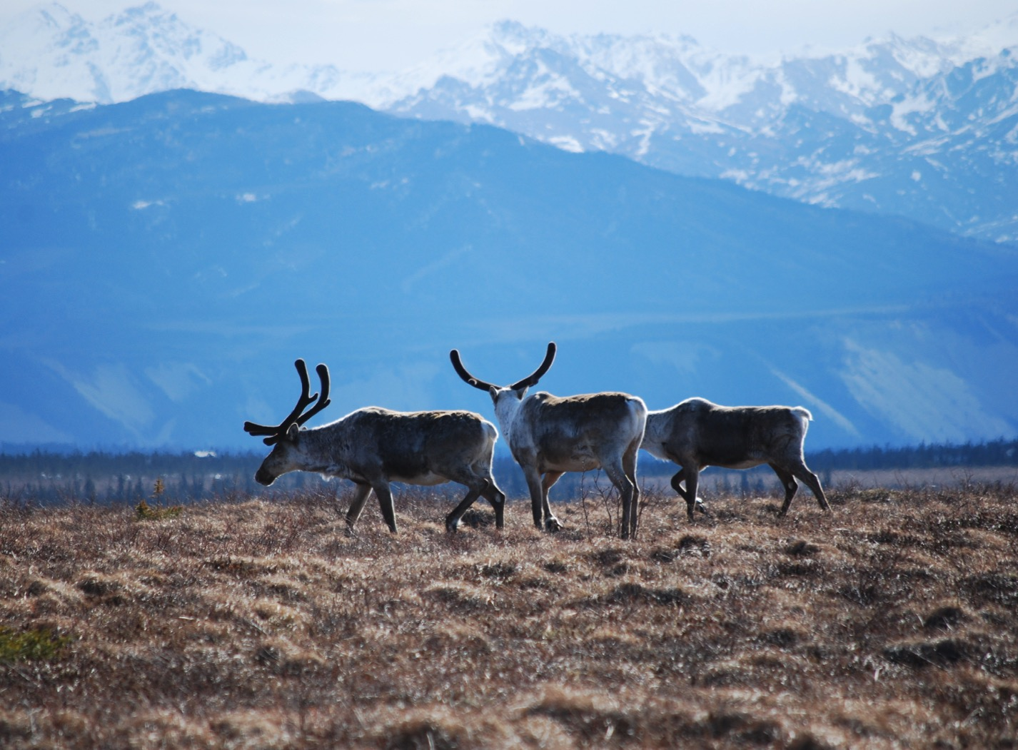
Arctic Boreal Vulnerability Experiment (ABoVE)
2017 ABoVE Airborne Campaign
28 April 2017 (DOY 119)
Atmospheric C: Yellowknife – Inuvik
Charles Miller, Deputy Science Lead
Jet Propulsion Laboratory, California Institute of Technology
and the ABoVE Science Team
For Hank Margolis, Eric Kasichke, Bruce Tagg
NASA HQ
April 2017

Slide 2
28 Apr 2017/DOY 119
Yellowknife – Inuvik
Assets Deployed:
Yellowknife – Mooney (N617DH)/Atmospheric CO2, CH4, CO
Daily Summary:
First Science Flight
All sensors operating nominally

Slide 3
28 Apr 2017/DOY 119
72-Hour Look Ahead
All plans weather dependent
Saturday 29 April 2017 (DOY 120):
Inuvik – Fort Yukon – Deadhorse
Vertical profiles over Old Crow, Fort Yukon, Toolik Lake, Deadhorse
ACTUAL: Inuvik – Old Crow – Fort Yukon - Fairbanks
Sunday 30 April 2017 (DOY 121):
Fairbanks – Galena - Nome
Vertical profiles over Galena, Nome
Monday 1 May 2017 (DOY 122):
TBD

Slide 4
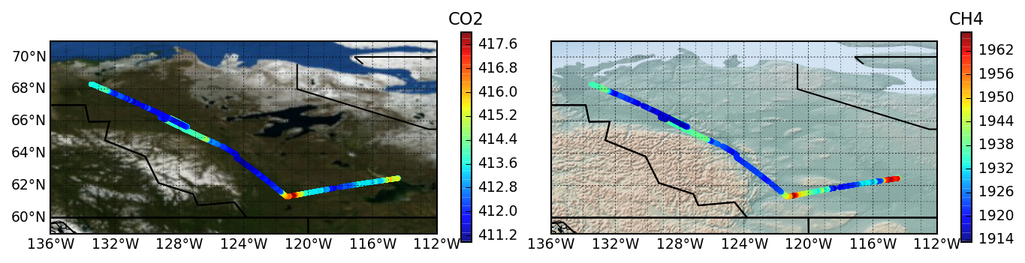
28 Apr 2017/DOY 119
Yellowknife – Inuvik
Flight Plan:
Yellowknife – Scotty Creek – Wrigley – Norman Wells - Inuvik

Slide 5
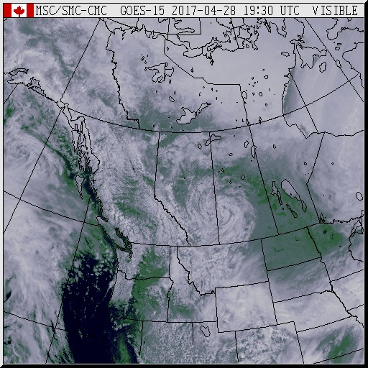
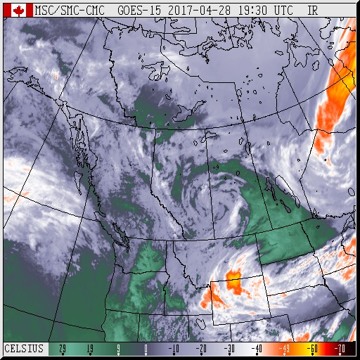
26 Apr 2017/DOY 117
Mooney Transit to Yellowknife
GOES VIS
GOES IR
GOES-15 Visible (left) and IR (right) show mostly clear conditions between Yellowknife and Inuvik

Slide 6
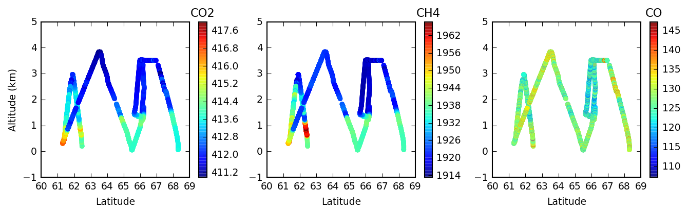
28 Apr 2017/DOY 119
Yellowknife – Inuvik
CO2, CH4 and CO vertical profiles vs altitude and latitude
Descents Scotty Creek, Norman Wells and Inuvik

Slide 7
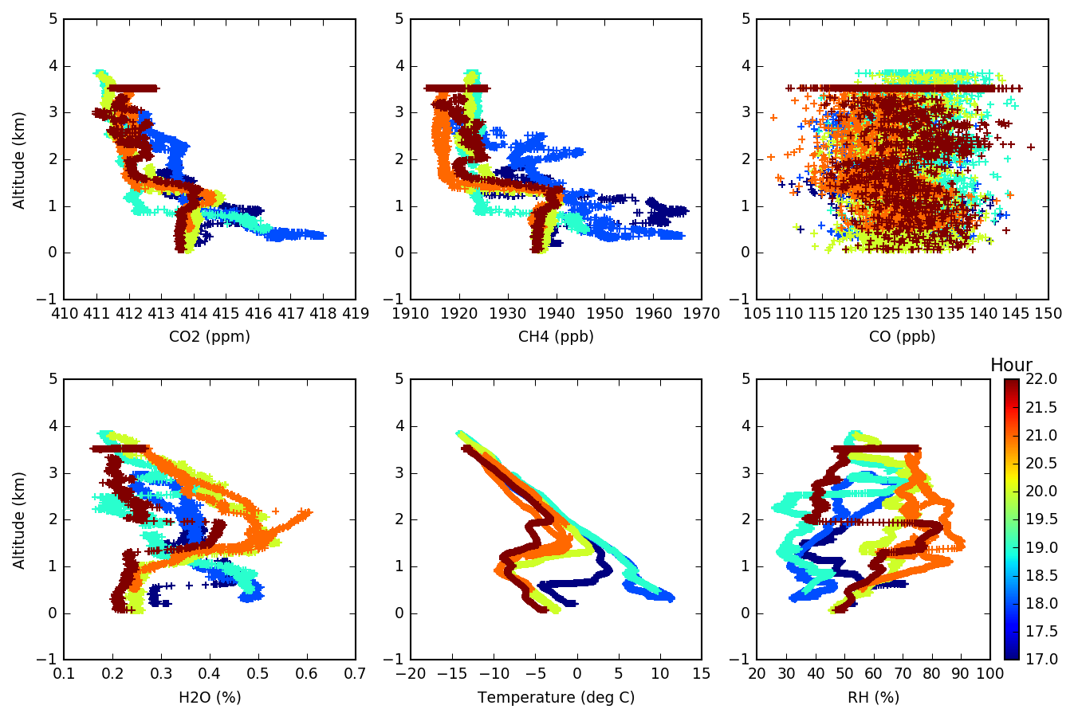
28 Apr 2017/DOY 119
Yellowknife – Inuvik

Slide 8
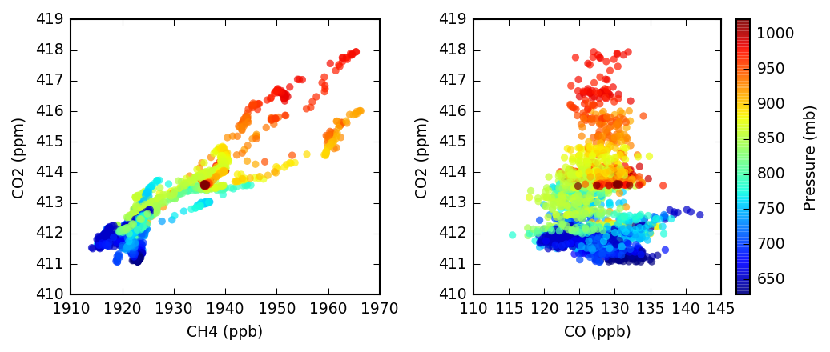
28 Apr 2017/DOY 119
Yellowknife – Inuvik
CO2 v CH4 and CO2 v CO tracer-tracer correlation plots
Near surface CO2 v CH4 shows evidence of spring thaw
No near surface CO suggests clean background air everywhere

